Slide 1
Intro to Python
Machine Learning

Slide 2
What We’ll Cover
What it is
What it isn’t
Defining our problem in terms of our data
Is it Supervised?
Is it Classification?
Is it Regression?
Is it Unsupervised?
The Importance of our Data

Slide 3
What it is
A way to group or predict new information, based on information we have seen before
“Given Age, and Height, what is someone’s Weight?”
“Given Petal Length and Width, what kind of flower is this?”
“Given a Patient’s clinical history*, what is the likelihood* they will have to enter the Emergency Department soon*?

Slide 4
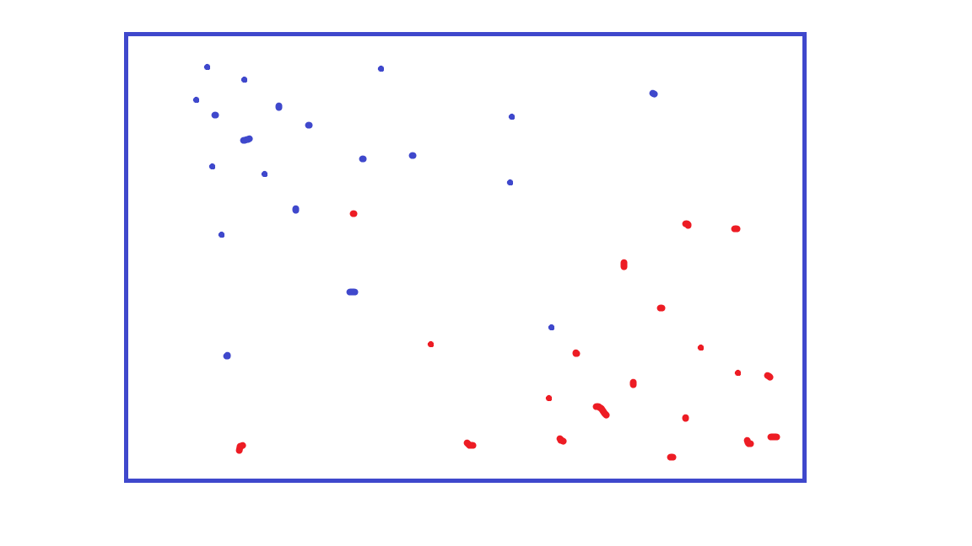
How can we divide this into Red vs. Blue?

Slide 5
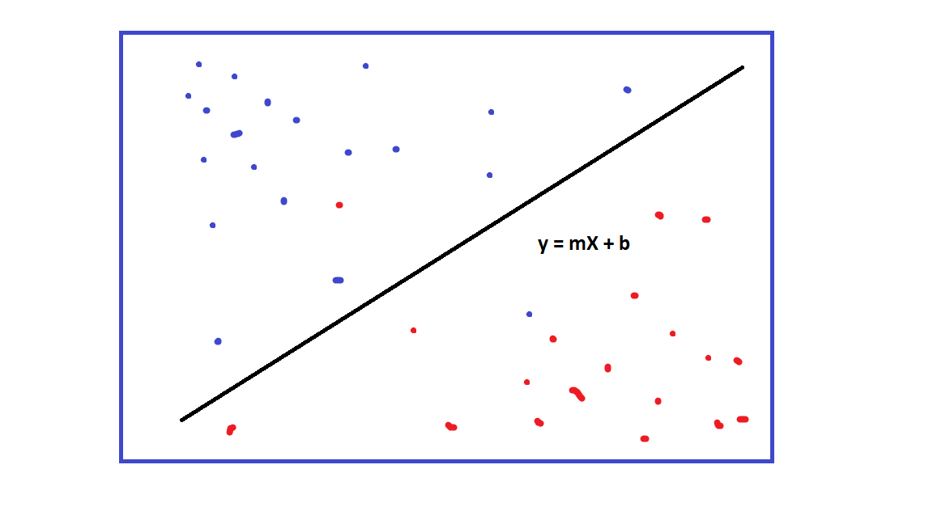
How can we divide this into Red vs. Blue?

Slide 6
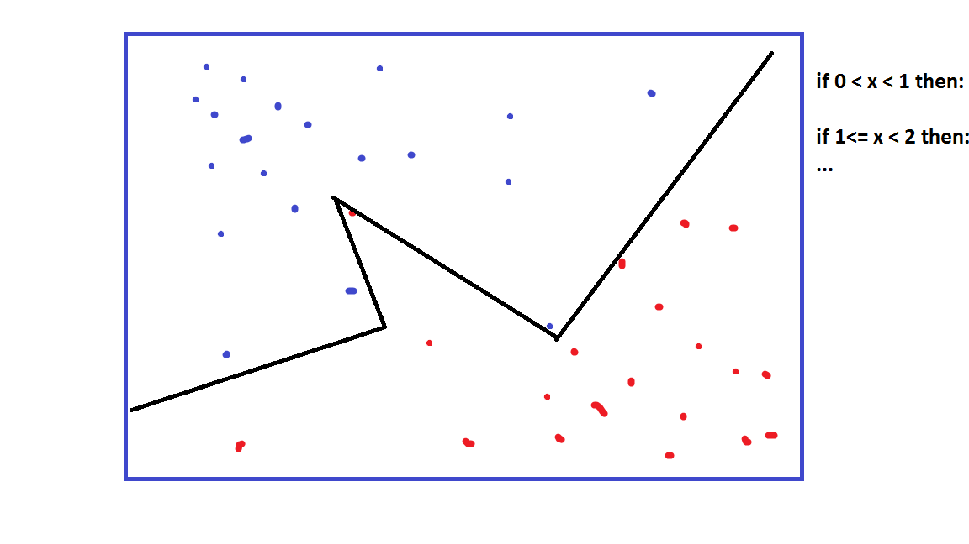
How can we divide this into Red vs. Blue?

Slide 7
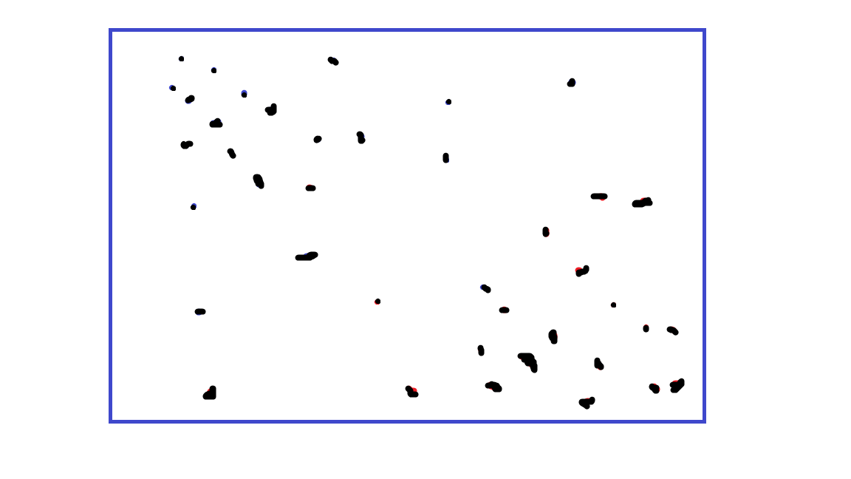
What about now?

Slide 8
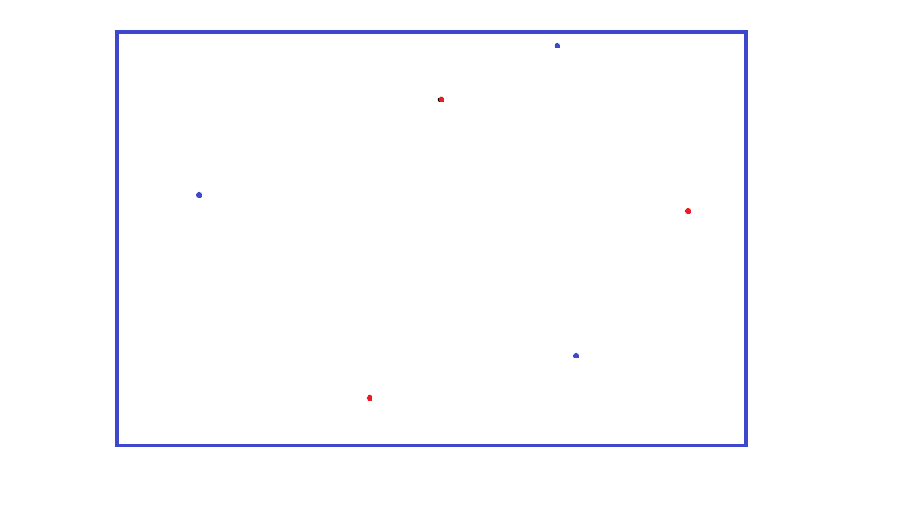
What about now?

Slide 9
What it isn’t
Magic
A Silver Bullet
Old Bay Seasoning, to be sprinkled liberally on an otherwise mundane application to give it a zesty new flavor
Machine Learning is not a substitute for good understanding of your problem!

Slide 10
INTERMISSION
Exploring some options for data transforming with scikit-learn

Slide 11
Defining our problem in terms of our data

Slide 12
Supervised Learning
Data “Prediction”

Slide 13
Is it a Supervised Problem?
Do we have data?
Do we have some feature within the data that represent what we ultimately want to predict?
If so, we can formulate it as a Supervised Problem
“Train” a model by predicting the label and comparing to the correct answer. Update the model when we are wrong.
“Test” the trained model by predicting the label of new data and evaluate
Our goal is a generalizable model- one that applies to new data well

Slide 14
Question Time
Why do we want to test on new data? What would happen if we didn’t?
We would already know the correct answer, since we have trained on it

Slide 15
What Problem Statement could we make?
Given a set of coordinates, will a point be Red or Blue?

Slide 16
Supervised Problems, cont’d: More things to consider
What is the best performance we expect from this predictor?
“If a human being made these predictions given this information, how good would they do?”
Is the data relatively sparse?
How much data is missing/has been imputed?
How many variables of input are there relative to the total number of examples?
How ‘True’ is the target?
Does it represent an estimate?
Are the targets we are trying to predict skewed?
Eg: 95% of all participants answered ‘No’, and 5% answered ‘Yes’

Slide 17
INTERMISSION
Making a simple supervised classifier (categorical) in jupyter

Slide 18
Supervised Problems: Categorical Problems
Can we state our outcome as a choice between of A vs. B?
Can be any number of categories
What problems could be introduced as we add more categories to an outcome to predict?
Target value sparsity
Need more data to keep the estimate solid

Slide 19
Quiz Time
Which of these are Supervised Learning Problems?
If we know someone’s demographics, can we guess their favorite movie genre?
What demographic sub groups exist of people that like Horror movies?
If we know someone’s demographics, can we guess their weight?

Slide 20
Supervised Learning: Regression Problems
Can we state our target as a real number?
https://en.wikipedia.org/wiki/Real_number
Since we don’t have distinct categories, we don’t have to worry how our data is binned (since there are no distinct bins!)
What problems do we have to be aware of?
Is our data representative of the problem?
Are we fitting the wrong regression model to our data?
Does our data have outliers that are throwing off our model?

Slide 21
Let’s make a problem statement!
From our clinical data (located at https://raw.githubusercontent.com/fredhutchio/R_intro/master/extra/clinical.csv )
Form a problem statement like “Given X, predict Y”
Given a Patient’s primary_diagnosis, tumor_stage and disease, predict vital_status
This is a Categorical problem. Why?
Given a Patient’s primary_diagnosis, tumor_stage and disease, predict days_to_death
This is a Regression problem. Why? Can we formulate it as a categorical one?

Slide 22
INTERMISSION
Making a simple supervised classifier (regression) in jupyter

Slide 23
Unsupervised Learning
Data “Expression”

Slide 24
Unsupervised Problems
Can we find out anything interesting by comparing aspects of our data to each other?
For our purposes, think of it as grouping our data, and assigning meaning to the groups after the fact

Slide 25
Unsupervised Problems, cont’d
Supervised problems can be characterized as having two phases: training and testing.
Unsupervised problems have a single phase: fitting

Slide 26
Question Time
Question: Why does a unsupervised problem only have a single phase?
Since there is no canonically ‘correct’ target/outcome to predict, there is no “training” to give better predictions, or “testing” to evaluate how generalizable our model is.

Slide 27
INTERMISSION
Performing simple unsupervised clustering (jupyter)

Slide 28
Closing Thoughts The Importance of Understanding our Data

Slide 29
Data is Messy
Most effort will be spent on cleaning, imputing, and transforming the data to make new or better input.
The second most effort will be spent on analyzing the results and figuring out if they are:
Meaningful
Good enough

Slide 30
You Will Not Have Enough Data
The more, and more varied the information you have, the more useful your model and predictions will be
Having too many variables (columns) and not enough observations (rows) leads to problems of sparsity
Having too little information to train over leads to ungeneralizable models or over-trained models (these are essentially the same thing)

Slide 31
Even when you have enough data, you may not have the complete picture
Some problems are just hard, and even trained experts will not agree on what constitutes “correct”
Problems can have factors that are not captured by your data
You cannot put together a whole puzzle with only half of the pieces

Slide 32
In Conclusion
Data predicates the model, not the other way around
A more complicated model is not a cure for poor or incomplete data

